Slide 1
Twitter Sentiment ANalysis
Classification
Name : Abdul Haseeb Arif
Reg no. : 2023-BS-AI-033

Slide 2
Introduction
Objective: Classify tweets into positive, negative, or neutral sentiments.
Use Case: Helps companies understand public opinion, monitor brand reputation, and improve customer engagement.

Slide 3

Dataset Overview
Source: Twitter dataset (Kaggle)
Features:
text: The tweet content
sentiment: The target label (positive, negative, neutral)
Size: [Update with actual row count]
Type: Natural Language Data (Text classification)

Slide 4
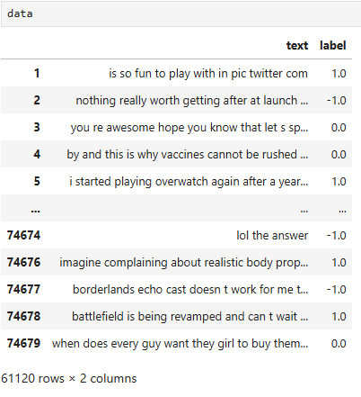
Exploring the dataset
An overview of rows and coulumns

Slide 5
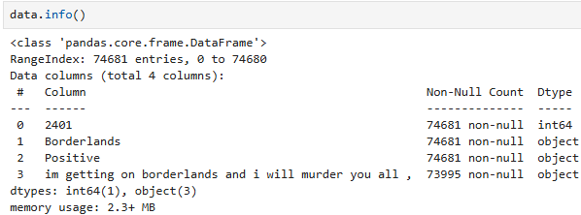
Exploring the dataset
A summary of the Dataset

Slide 6
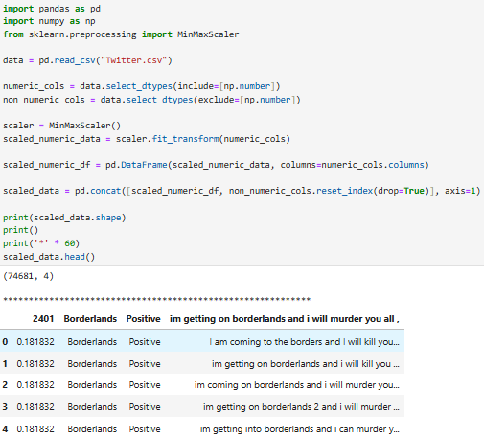
Preprocessing Steps
Normalization
Scaled or normalized feature vectors to improve model performance

Slide 7
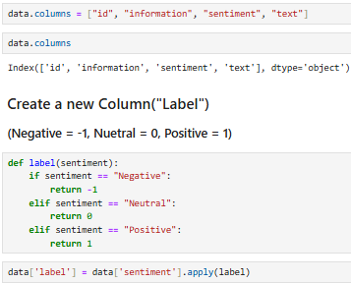
Preprocessing Steps
Assigning column names

Slide 8
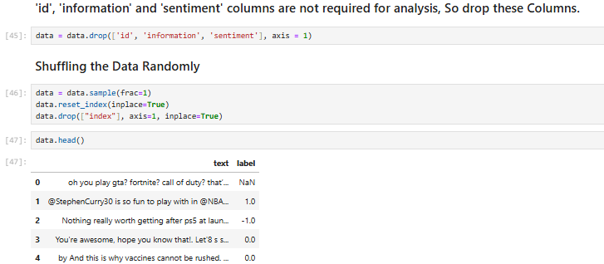
Preprocessing Steps
Arranging the columns

Slide 9
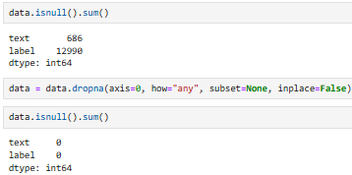
Preprocessing Steps
Checking Null values and Dropping the Row with Null Value.

Slide 10
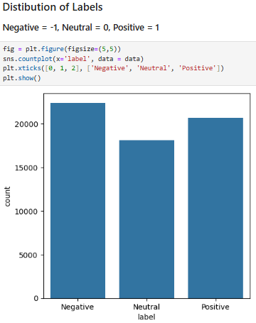
Preprocessing Steps
Visualizing Data

Slide 11
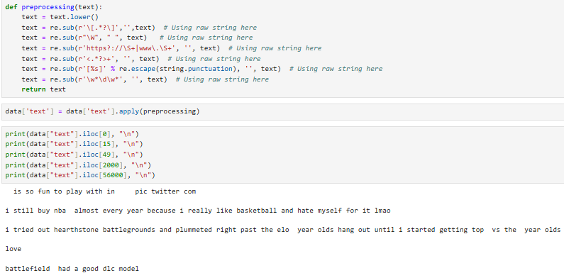
Text Preprocessing
Text Cleaning
Removed punctuation, stopwords, URLs, mentions (@user), and hashtags (#topic)

Slide 12

Defining dependent and independent variable as x and y.
x (Features): The tweet text, which holds the input information used to predict sentiment.
y (Target): The sentiment label, which is what your model is trying to learn and predict.

Slide 13

Convert text to vectors
Vectorization
Transformed text into numeric format using TF-IDF or CountVectorizer

Slide 14
Train-Test Split
Split data into training (80%) and testing (20%) sets

Slide 15

Modeling
Logistic Regression
A linear model used for binary and multiclass classification
Works well with high-dimensional text data (like TF-IDF vectors)
Interpretable and efficient for large datasets

Slide 16

Accuracy Test
Checking Accuracy of the model

Slide 17
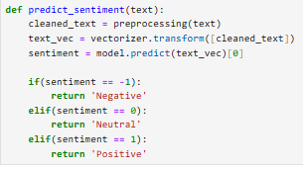
Evaluation
Accuracy: Measures the overall proportion of correct predictions.
Precision: Measures how many predicted positives are actually correct.
Recall: Measures how many actual positives were correctly identified.
F1-Score: Combines precision and recall into a single balanced metric.
Confusion Matrix: Displays a table of correct vs. incorrect predictions for each class

Slide 18


FInal Input and Output
InPut
Output

Slide 19
Key Findings
Most tweets are either clearly positive or negative, few are truly neutral
Text pre-processing significantly improves model performance
Logistic Regression and SVM often outperform Naive Bayes on clean text

Slide 20
Conclusion
Successfully built a sentiment classifier with good accuracy
Model can be applied to real-time Twitter data

